Slide 1
Menu Tingz Testing Report
Group: K.O.D Inc
Members: Ottor Mills
Kenneth Anglin
Nicoy Smith
David Thomas

Slide 2
What is Menu Tingz
Menu Tingz is an android application which allows users view and order dishes from various restaurants listed within the application.

Slide 3
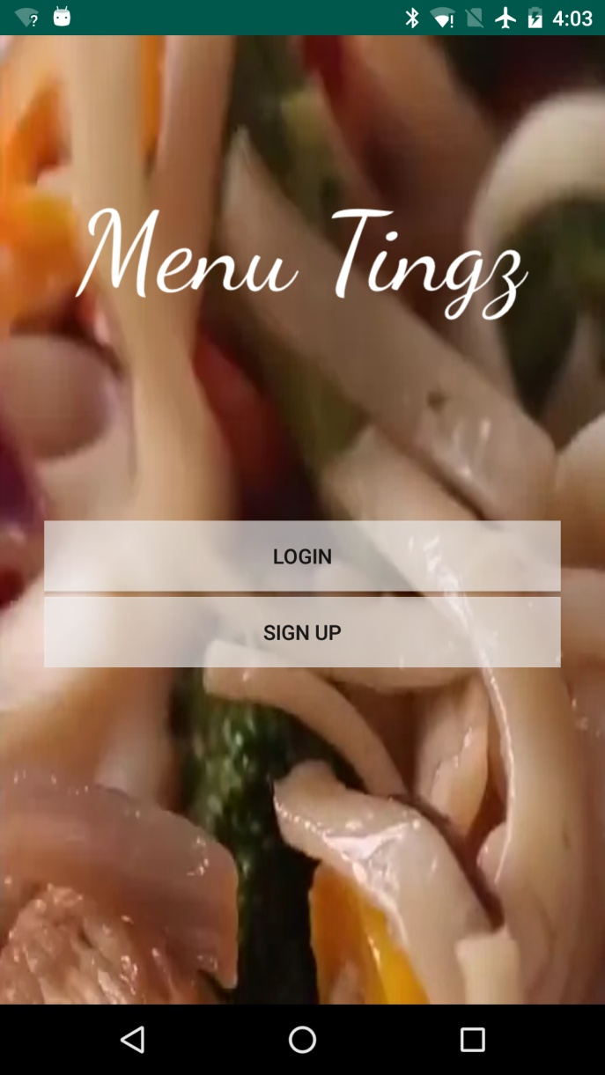
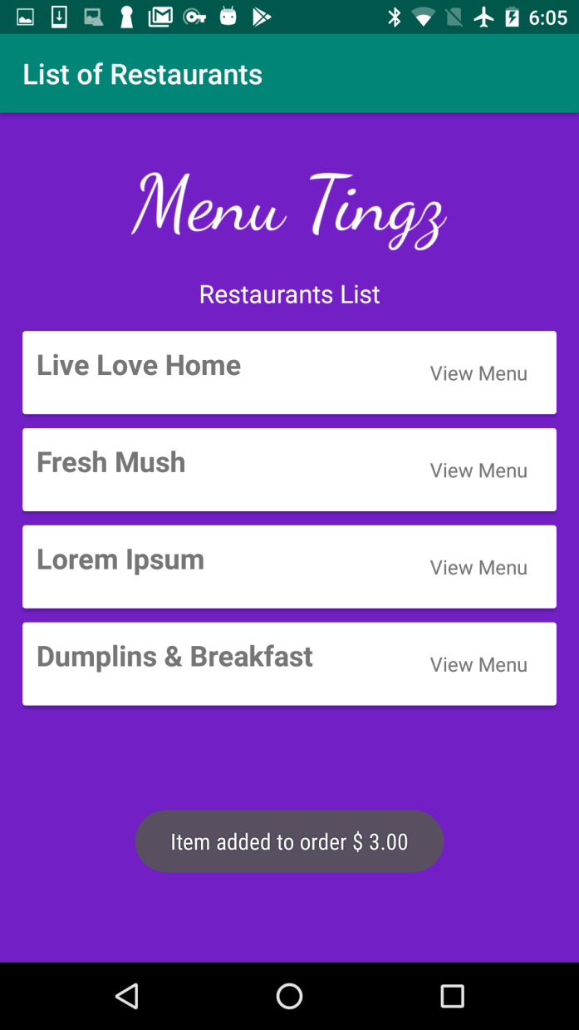
User Interface

Slide 4
User Interface (Contd.)
Upon signing in the total number of event flows is very small. Possible flows consist of selecting from available options. This results in a very low chance of an error occurring therefore automated testing is not strictly necessary in this regard. On the other hand, the login and sign up forms may be vulnerable to malformed inputs and as such automation is necessary.

Slide 5
Vulnerability Testing
The testing method used is vulnerability testing, where many possible text combinations will be tested in the input fields. The order of growth of this operation is exponentially large and will take a long a long time as the domain input variable, such as length and possible characters, grows. As such multiple threads with headless emulators are recommended to reduce runtime.

Slide 6
Vulnerability Testing (Contd.)
This test consisted of a feature file in combination with a JavaScript program. The feature file acted as a template and the JavaScript program made changes to this file to carry out each test case. Once changes were made to the file it was executed using a subprocess.

Slide 7
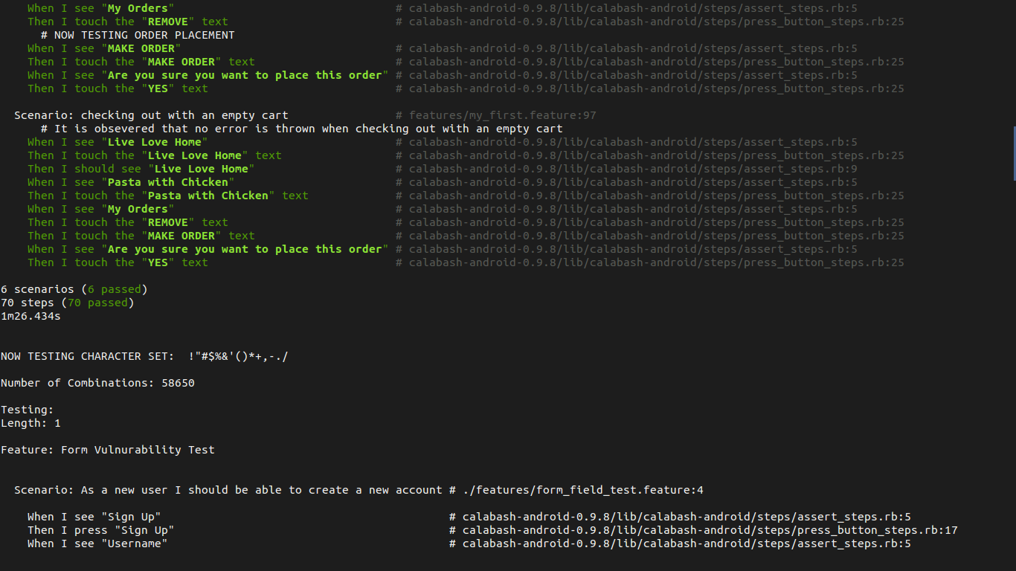
Sample Output

Slide 8
Noteworthy Discoveries
App allows for weak usernames and passwords
No max length of the form fields
Screens aren’t properly stacked
Sqlite database appears to be vulnerable to injection attack

Slide 9
Video
(Attachment file not found)

Slide 10
The End
Any Questions?

